Slide 1

Cross selling recommendation
Exploratory Data Analysis
Name: Shreya Ramachandra
Email: ramacha4@uwindsor.ca
Country: Canada

Slide 2
Cross Selling in Bank
Cross-selling products in a bank refers to the practice of promoting and selling additional financial products or services to existing customers
It is a great way of increasing customer loyalty and customer relationships which in turn can improve customer lifetime value and retention
Cross-selling can also help banks to generate additional revenue by offering customers a range of products and services
To effectively cross-sell products in a bank, it is important to have a deep understanding of the customer needs through data analysis and customer feedback
Banks can also use various marketing strategies to promote cross-selling, such as targeted email campaigns, personalized offers, and in-branch promotions

Slide 3

Problem Statement
The XYZ credit union in Latin America, known for its successful sales of credit cards, deposit accounts, and retirement accounts, is encountering difficulties in enticing its current clients to buy supplementary products or services. This failure to cross-sell is affecting the credit union's financial results, including its revenue, profits, and customer retention

Slide 4
Business Understanding
Business understanding through exploratory data analysis can help the XYZ credit union in Latin America better understand the root cause of its difficulties in cross-selling additional products and services to its current customers. By collecting and analyzing relevant data, the credit union can gain insights into customer behavior, preferences, and purchasing patterns. This information can then be used to develop targeted cross-selling strategies and campaigns that are more likely to resonate with its customers
Some specific data points for analysis include:
Customer demographics: Understanding the age, gender, income, and other demographic characteristics of the credit union's customers can help identify any patterns or trends in their purchasing habits
Product usage data: Analyzing data on which products and services are being used the most (and least) by the credit union's customers can help identify opportunities for cross-selling

Slide 5
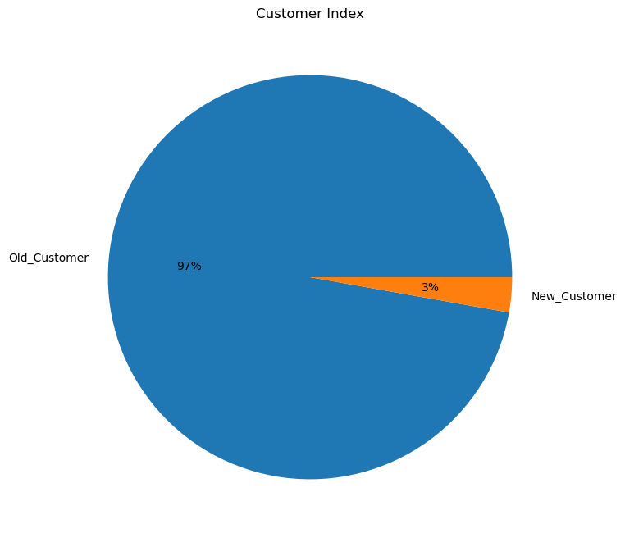
Exploratory Data Analysis: Insights
Despite its efforts to expand its customer base, the bank has struggled to attract new clients. As a result, the proportion of new customers that the bank values is relatively low, accounting for only 3% of its total customer base
To address this issue, the bank will need to conduct a comprehensive analysis of its customer acquisition strategies and determine why it is struggling to attract new customers. This could involve examining factors such as market competition, changes in customer preferences, or limitations in its marketing and sales efforts

Slide 6
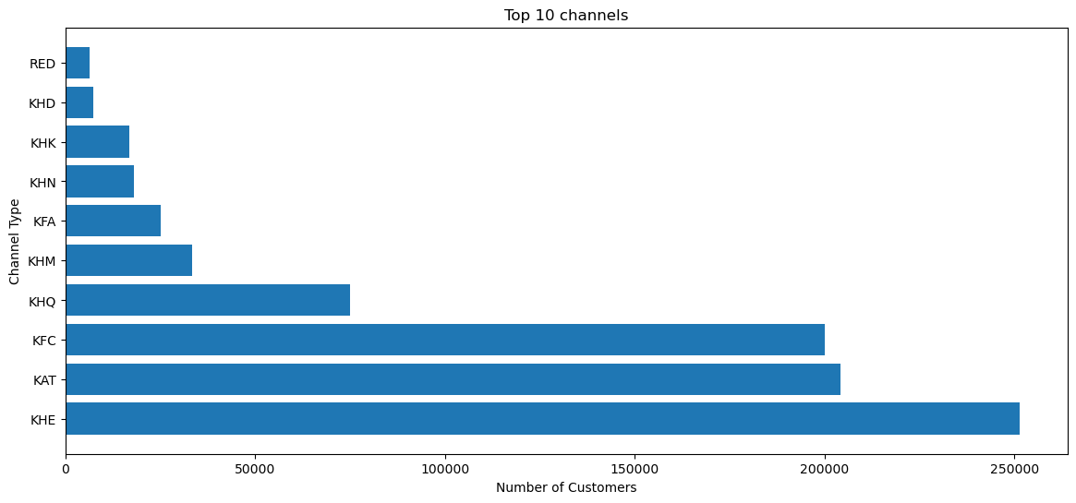
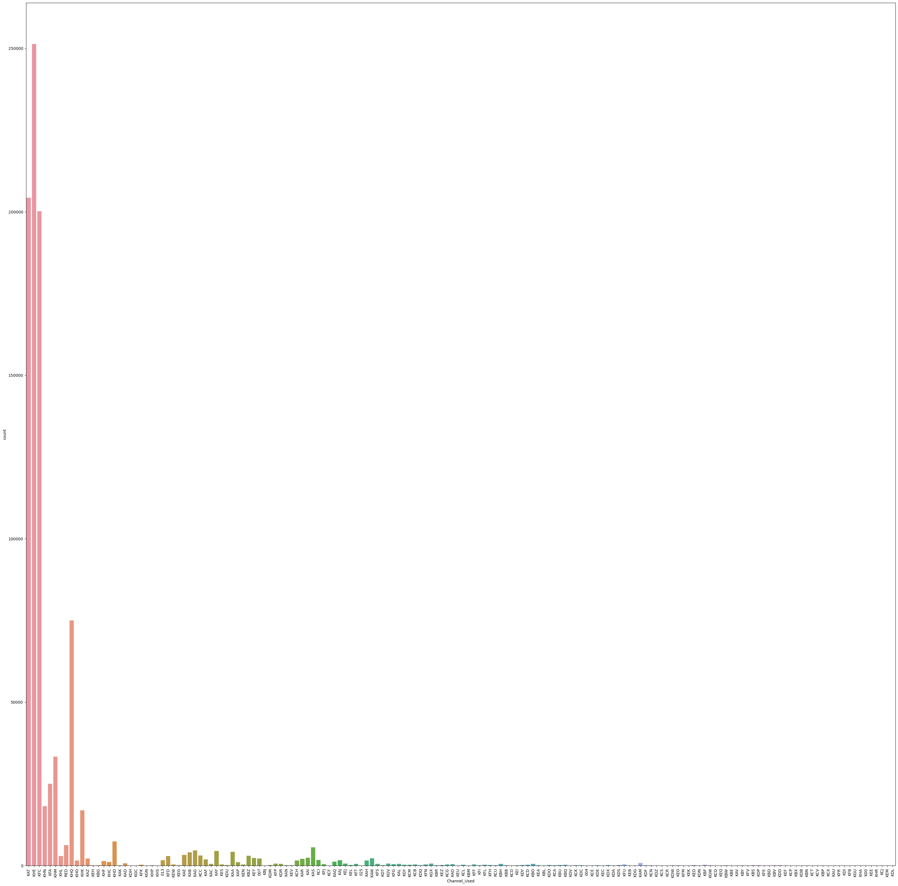
Number of channels used
The top 10 customer acquisition channels have been successful in bringing new customers to the credit union, as more than 25,000 customers have joined through these channels

Slide 7

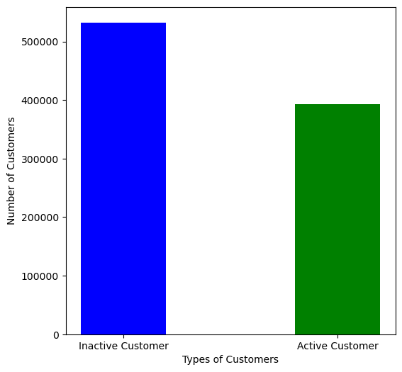
The bank has a higher number of inactive members, numbering at 50,000, compared to the number of active members

Slide 8
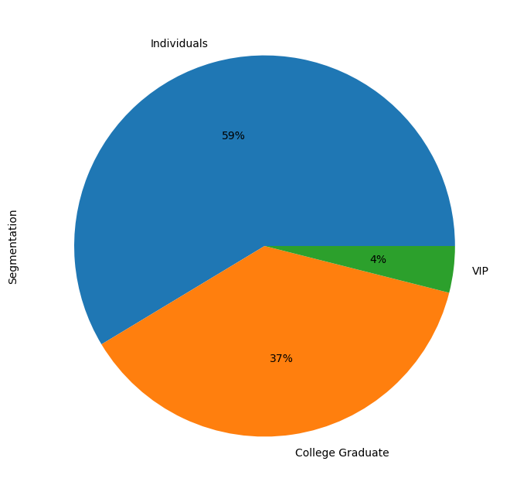
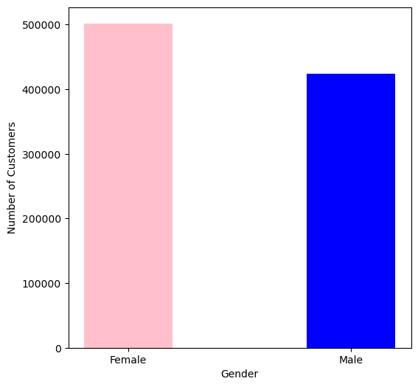
Women make up the majority of the bank's customers, comprising a larger proportion of the customer base by 10% compared to men
The bank has a greater number of individual customers, making up 59% of the total, compared to college graduates and VIP customers who make up 37% and 4% respectively

Slide 9
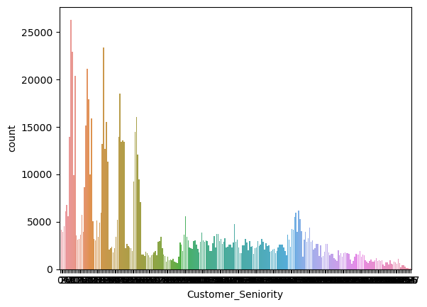
Seniority Count plot

Slide 10
Recommendations
Establish strategies for retaining inactive customers and converting them into active customers, through targeted marketing campaigns or personalized communication
Offer incentives or rewards to new customers to increase their value to the bank and attract even more new customers
Study the demographics and behaviors of both active and inactive customers, as well as the differences between individual customers, college graduates, and VIPs, in order to tailor marketing efforts and improve customer engagement
Prioritize the marketing and outreach channels that have shown the most success, such as the top 10 channels, and allocate resources accordingly
Continuously evaluate and improve customer service and support, as this can have a significant impact on customer satisfaction and loyalty
Expand the bank's product and service offerings to appeal to a wider range of customers and meet their evolving needs
Collaborate with other businesses or organizations to broaden the bank's reach and bring in new customers

